Slide 1

Case study - Data annotation and data labeling services For ML
Business Challenges During ML
Understanding Which Processes Need Automation
Lack of Quality Data
Inadequate Infrastructure
Implementation
Lack of Skilled Resources
Time taken to train the Model
Solution Overview
A properly labeled dataset provides a ground truth that the ML model uses to check its predictions for accuracy and to continue refining its algorithm
Speed and Efficiency
Quality with Accuracy
Key Benefits
Provide high quality data for training train ML models.
The global data annotation market size is expected to reach US$1.6 billion by 2025, according to a new study by Grand View Research
Low-cost Training Data for AI & ML
Scalable Solution for Varied Needs

Slide 2
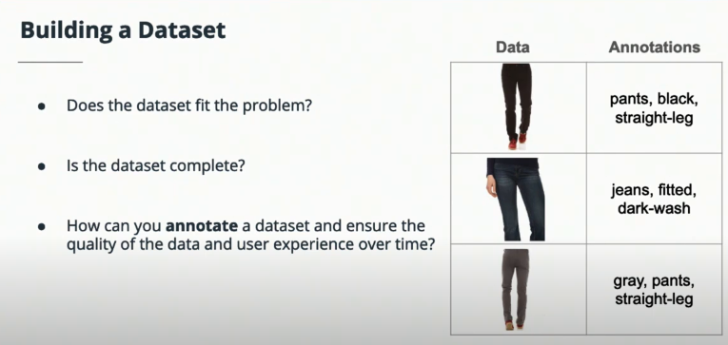
Case Study - Image annotation in retail and e-commerce industry
Case Study Brief
Customer is a global leader in connected retail and e-commerce industry. They want to automate the process using AI.
Business challenges are:
Does the dataset fit the problem?
Is dataset complete?
How can you annotate a dataset and ensure the quality of the data and user experience overtime?
Solution Overview
Use production data to ensure the training data matches the real world scenarios.
Customized data annotation.
Data annotation open source tools(Cvat, Labelbox, Label Studio ).
Determine the success criteria for a trained model :
Precision
Recall
F1 score
If not met – retrain, go back to the data

Slide 3
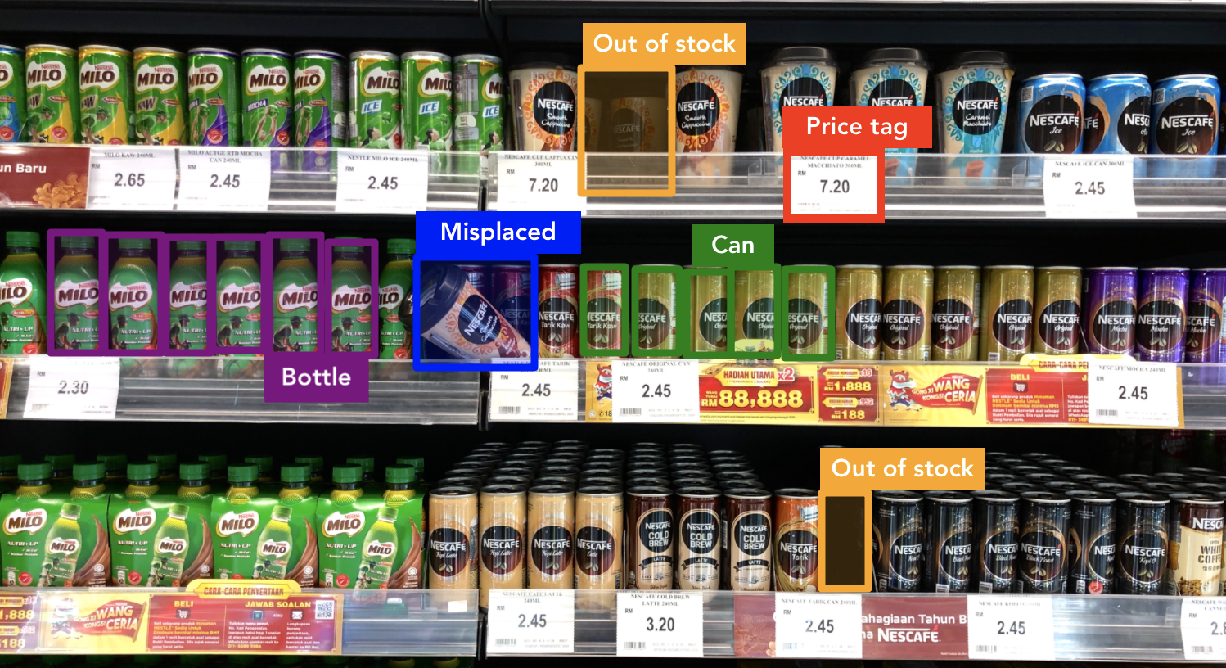
Case Study – Image annotation in retail and e-commerce industry
Key Benefits
A better user experience for shopping by giving them exactly what they’re looking to buy.
Annotating images online and tagging with specific captions and keywords to make it easier to classify products.
A well-done image annotation process will ensure that products are categorized accurately.
Tagging images properly helps to improve the search relevance to make relevant recommendations.
Skilled annotators accurately label and classify these objects for an AI-backed interactive site to recognize objects and make the product search experience comfortable.
Experienced image annotation teams annotate images of shelves, prices, brands, and products so companies can track shelf management.
Identify items that have been misplaced, and quickly conduct price checking.
Forecast Downtime Prediction Accuracy > 77%

Slide 4

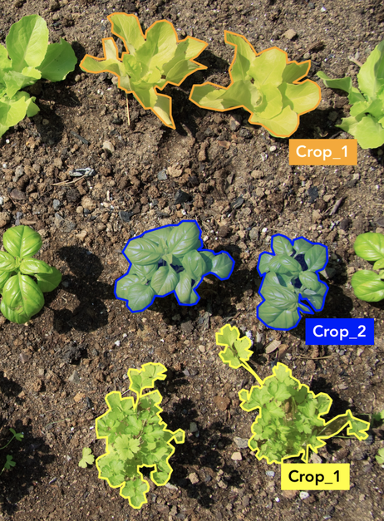
Types
Types of Image Annotation
Bounding box Polygon annotation

Slide 5
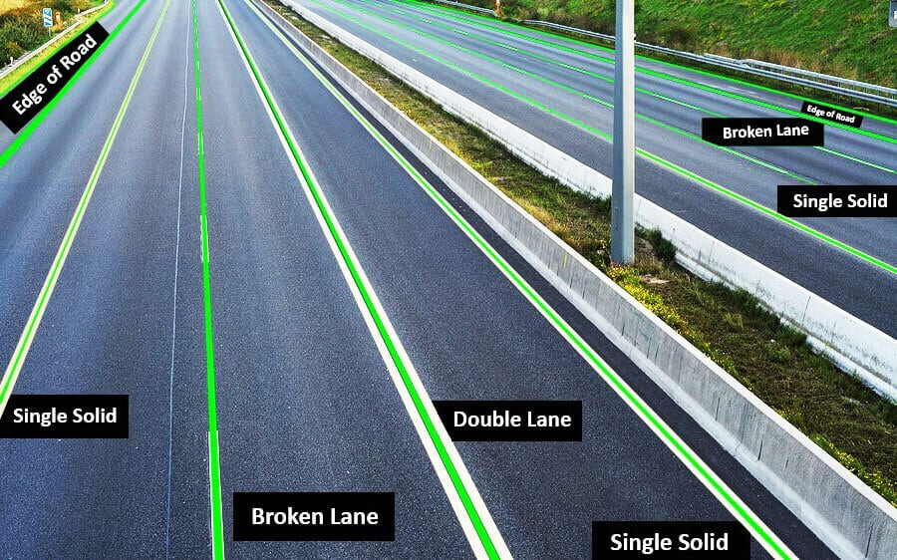

Types
Types of Image Annotation
Line annotation Point annotation

Slide 6
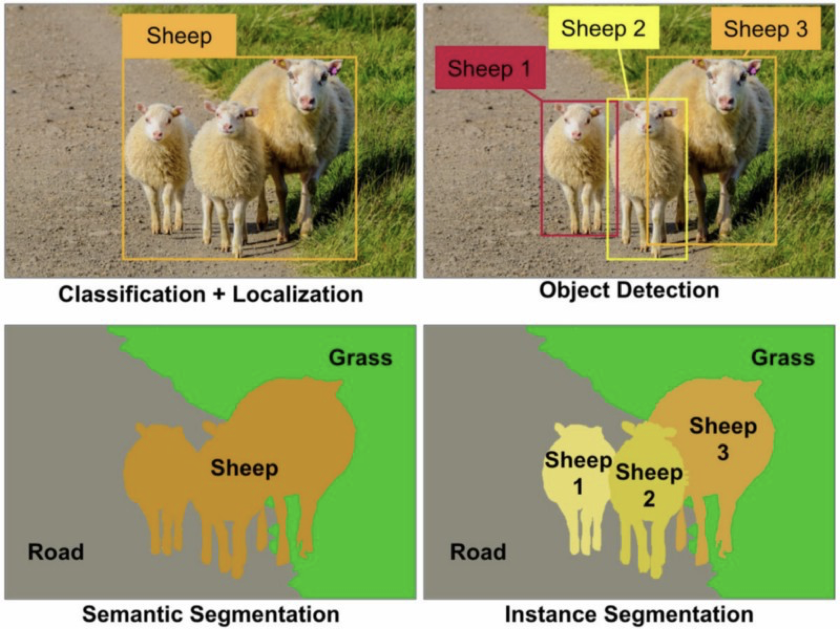
Types
Types of Image Annotation
Semantic Segmentation & Instance Segmentation

Slide 7
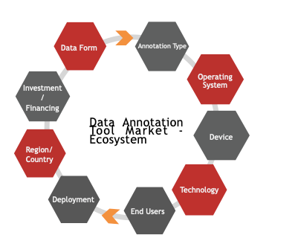
Data Annotation - Ecosystem

Slide 8
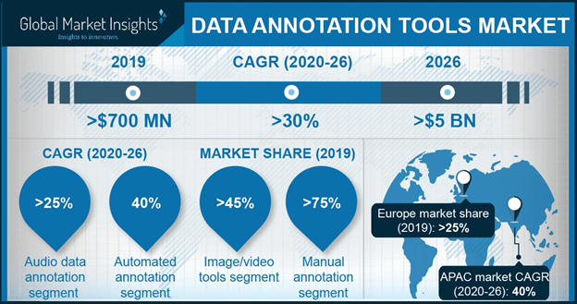
Global Market Insights

Slide 9
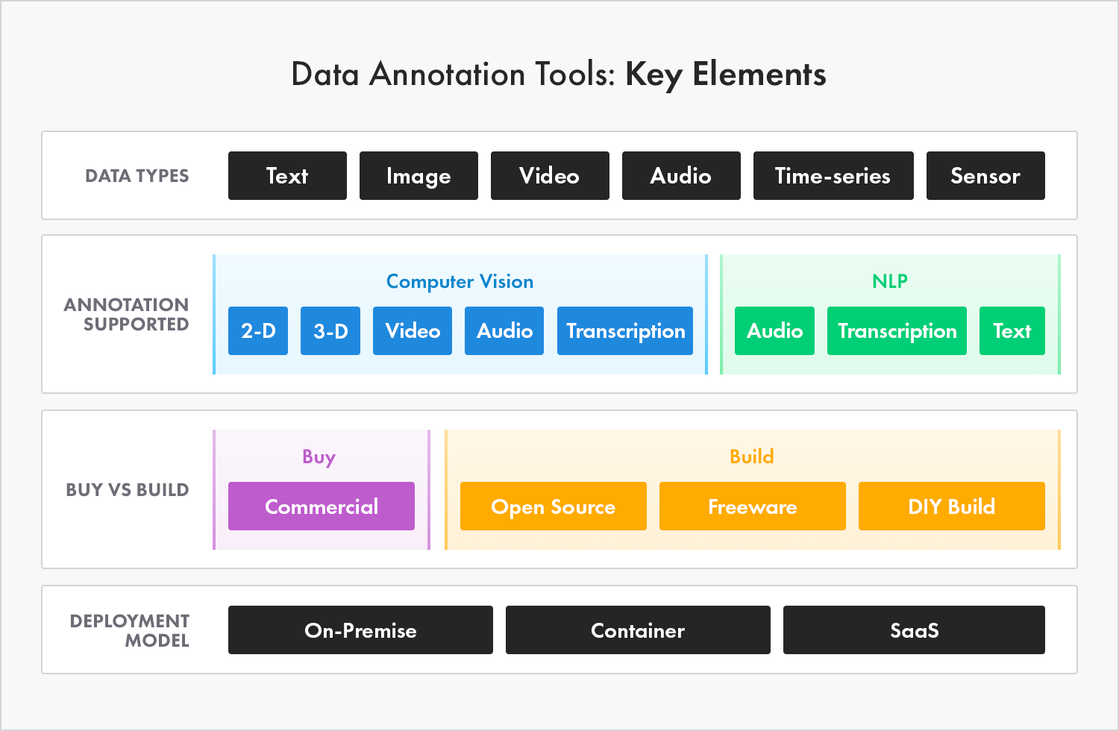
Data Annotation Tools : key elements

